Slide 1
Asteroidal & Lunar Occultations: Results 2014-2015
Dave Herald

Slide 2
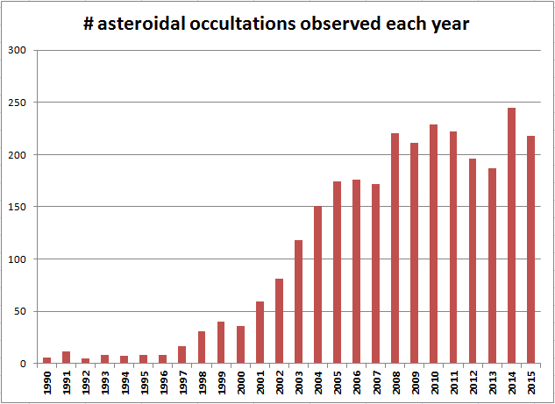
About 210 events each year

Slide 3
Number of successful events by region, and max # sites: 2015/01 2015/12
Australasia 44 (16 sites)
Europe 61 (50 sites)
Japan 25 (17 sites)
US 88 (27 sites)

Slide 4
Double stars discovered in asteroidal occultations
New double stars can be discovered in an asteroidal occultation
Separations are usually in the range 0.1” to 0.001”
If several observers, the uncertainty in separation can be less than 1 milli-arcsecond [ <0.001”]

Slide 5
5 double stars discovered since Jan 2014
Star number Sep (mas) P.A. Date Asteroid
0801-01593-1 1.2 292.3 2014 Jan 18 664 Judith
5227-00026-1 3.0 2.0 2014 Dec 9 3950 Yoshida
2U27496405 10.0 ± 0.5 225.8 ± 2.5 2015 Feb 12 107 Camilla
0283-00694-1 42.1 ± 0.7 127.9 ± 1.4 2015 Apr 2 90 Antiope
4UC344-090563 41.0 247.0 2015 Aug 5 92 Undina
Note – the first three are below the resolution limit of Gaia

Slide 6
8 examples of good Profiles

Slide 7
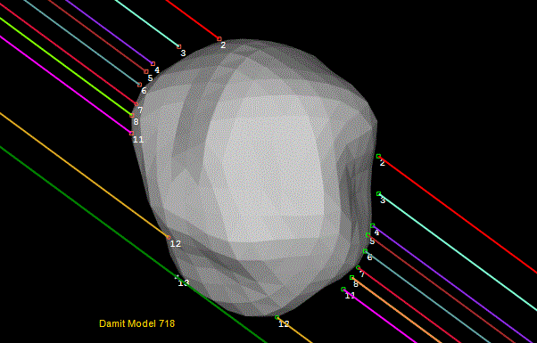
93 Minerva 2014 Sep 6
A good fit to a convex shape model

Slide 8
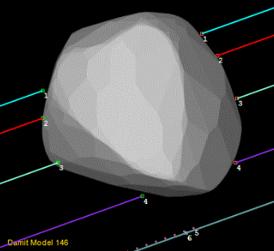
82 Alkmene 2014 Sep 18
A good fit to a shape model

Slide 9
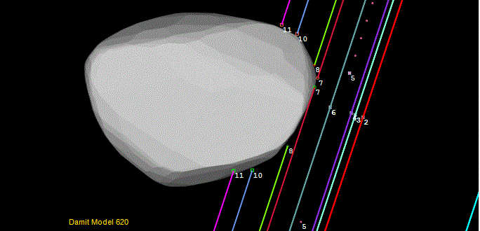
166 Rhodope 2015 Jan 30
With Gaia, multiple Miss events like this should become less common

Slide 10
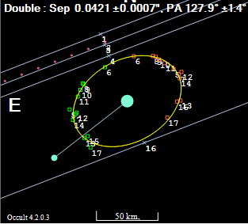
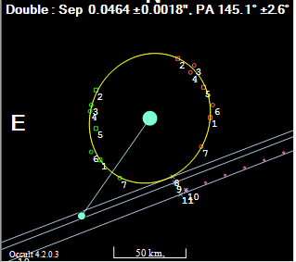
A double-double occultation
On 2015 Apr 9 the binary asteroid 90 Antiope occulted a star that turned out to be double.
Double star solution from each component of the asteroid

Slide 11
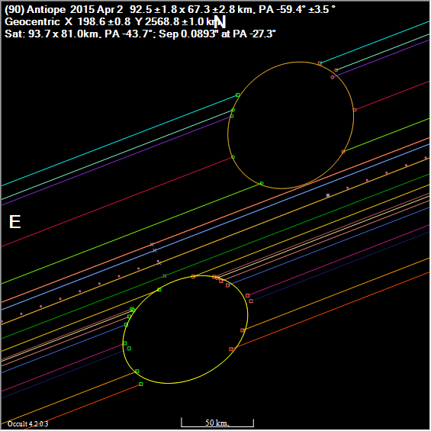
Solution for the asteroid

Slide 12
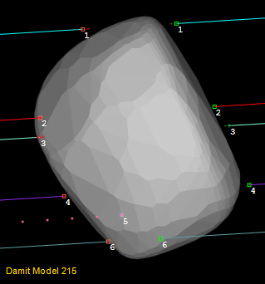
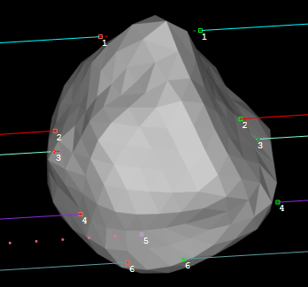
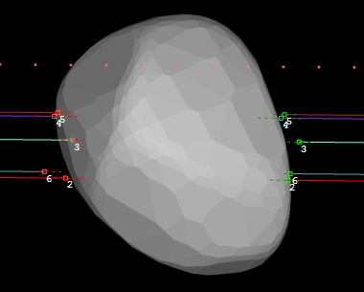
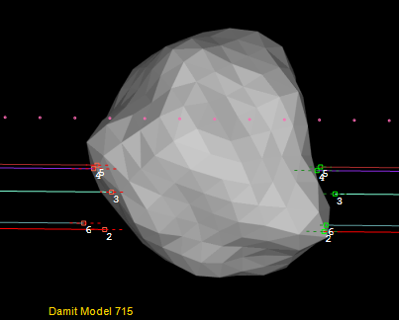
409 Aspasia 2015 Sep 4, and Aug 8
Model 215 (Convex) Model 715 (Concave)
Sept 4
Aug 8

Slide 13
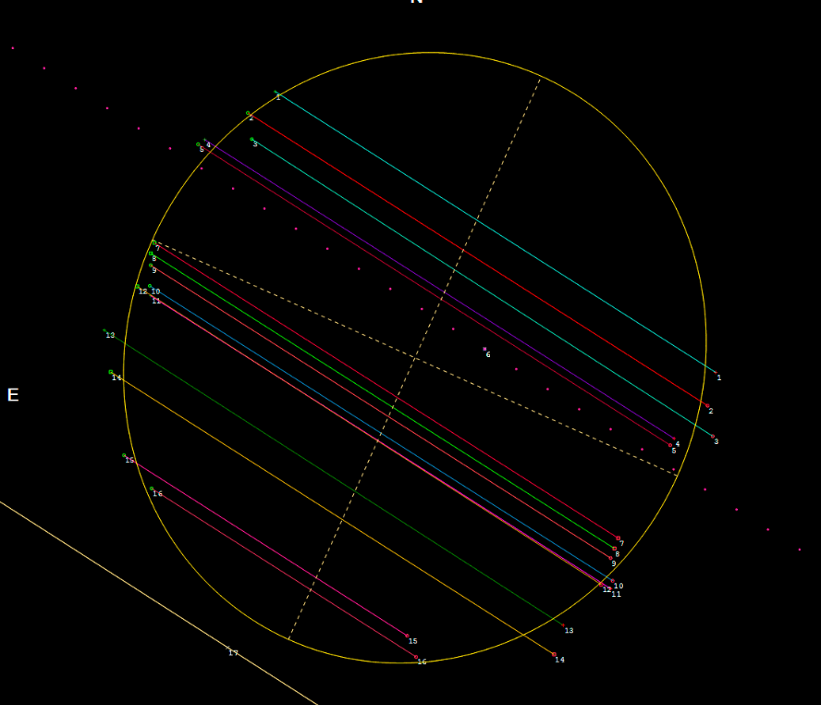
275 Sapientia 2015 Sep 30
No shape model available

Slide 14
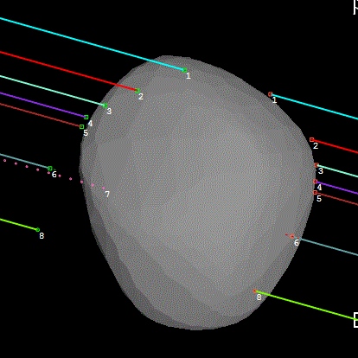
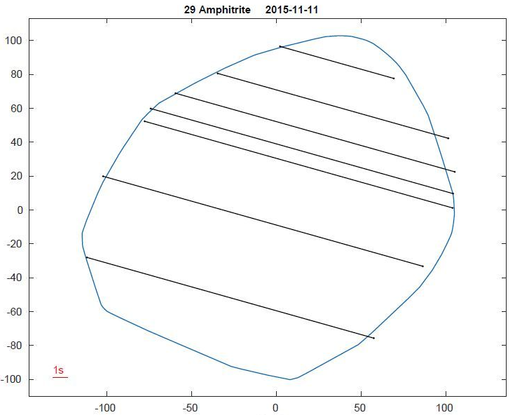
Amphitrite – 2015 Nov 11
‘old’ model updated shape model

Slide 15
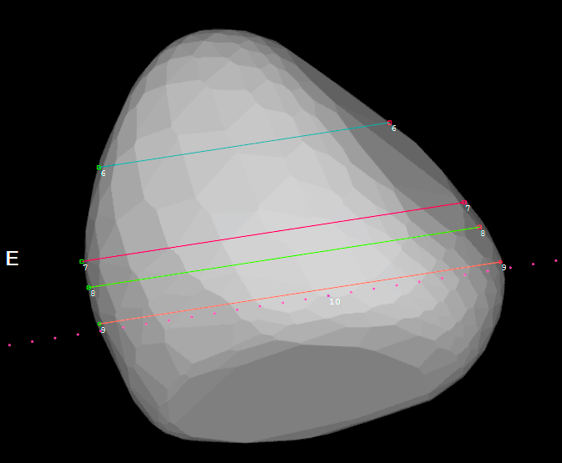
27 Euterpe 2015 Dec 13

Slide 16
Any questions?

